Slide 1

C++ in Containers
Marc Goodner
Principal Program Manager
C++ team at Microsoft
Visual Studio and VS Code

Slide 2
Containers
More efficient than a VM
Not abstracted from the host via a hypervisor
Container engine provides runtime environment
Share host OS kernel
Lower disk cost
Self contained dependencies
Application and dependencies isolated from host environment
Easily run anywhere
Isolation
Host resources isolated from containers
Containers are isolated from each other

Slide 3



Why C++ and containers?
Size
Performance
Scale

Slide 4
Build containers
Single file that describes a reproducible build environment
Clean from the host machine

Slide 5
Demo
Build container
Notes:
Press ESC to exit presentation mode

Slide 6
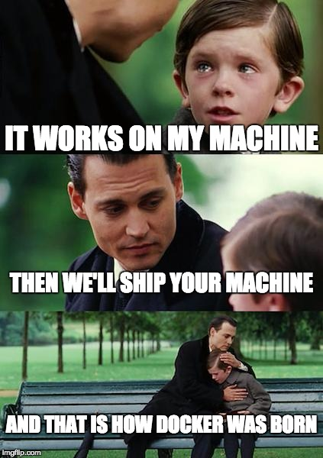

Slide 7
C++ apps in containers - microservices
Smallest units of logical work
Resiliency
Different host environments
No dependency conflicts
Scale up units independently as needed
Externalize concerns to where they are best handled
Multistage builds for consistent build and runtime environments

Slide 8






Find faces C++ web service
Nodejs
web app
Traffic
Nginx
proxy server
C++ service
OpenCV face
detection

Slide 9
Demo
C++ web service
Notes:
Press esc to exit presentation mode

Slide 10
Demo app review - findfaces
Multistage build container for C++ web service
docker build --target build -t findfaces/alpine-build .
docker build -t findfaces/alpine-run .
Define the related services in docker-compose.yml
Configure the nginx proxy server settings
Be mindful of calls being made inside the container network or external
docker-compose up -d
docker-compose down

Slide 11
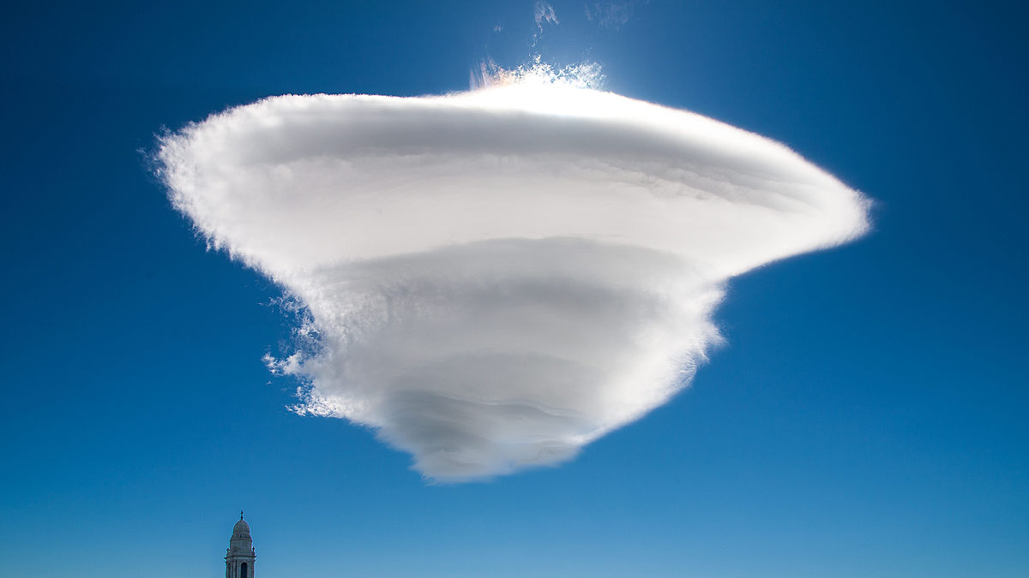
What about the cloud?

Slide 12

Orchestration
Coordinating work across containers

Slide 13
Kubernetes overview
Cluster
Node
Pod
Container
Container

Slide 14
Kubernetes overview
Cluster
Node
Node
Node
Pod
Pod
Pod
Container
Container
Container
Container
Container
Container

Slide 15
Kubernetes overview
Cluster
Deployment
Node
Node
Service
Pod
Pod
Job
Container
Container
Container
Container
PVC

Slide 16


What’s our scenario?

Slide 17
Can ants sort tiny screws in space?
How can you tell? Count screws sorted by ant type?
This was the 90s…
…probably CSV data
…probably batch processing of data from yesterday
…C++ was cool
Its been years. More ants, more sensors, more data
Need to get app off old system
How can we preserve it?
Can we also scale it?

Slide 18
Counting tiny screws sorted by ants in space
PVC
/data
Job
antspacedata
antfilequeue.py
Deployment
Redis
antfiles
Service
antscrewcounter
Job
antworkerqueue.py

Slide 19
Demo
Kubernetes
Notes:
Press ESC to exit presentation mode

Slide 20

Ants sorting tiny screws in space… finally counted

Slide 21
Counting screws in review
Resources to distribute work
Redis deployment and service for work queue
Persistent Volume Claim for saving data beyond lifecycle of pods
Generating antfiles
C++ app to generate an arbitrary number of csv files
Python script as entry point to kickoff generation and put files in work queue
Kubernetes run to completion job
Counting screws
C++ app that takes a csv file as input
Python script as entry point that reads file from queue and invokes C++ app
Kubernetes job that enables running pods in parallel

Slide 22
What we saw
C++ and containers have complementary characteristics
Building in containers is valuable and easy to get started
Multistage builds keep your build and runtime definitions in sync
C++ has a place in containers beyond just build environments
Externalize concerns to where they are best handled
C++ can be used in modern cloud deployments
Kubernetes can be used to parallelize your C++ workloads

Slide 23
What now?
Learn and share how to deploy C++ apps in a modern cloud environment
Deployment practices for C++ apps in containers are not well known
What communication protocols are best for C++ apps in containers?
What are the best ways to parallelize work for C++ apps in containers?
How can you take an on prem C++ app, containerize it, and shift it to your favorite cloud?
How are libraries best managed in a containerized environment?
What are best practices for managing build and run containers in a CI/CD system?
How does any of this work with Windows C++ apps?

Slide 24
References
WTF is a container?
Dockerizing a simple python process
Kubernetes overview
http://kubernetesbyexample.com/
Parallel Processing with Jobs documentation
CSV Game, yes C++ is the fastest
MSVC in a container
Using VS Code for C++ with containers
https://github.com/robotdad, source for demos will be posted here

Slide 25
Troubleshooting
Make sure a locally built binary is not in your source directory
Use the .dockerignore file to keep things out of your container
Change your container entrypoint to run interactively
docker run -it --entrypoint=sh imagename
Check logs of K8S pods
kubectl logs podname
Start a bash shell in a running K8S pod
kubectl exec -it podname bash
Alpine can be tricky, try adding libc compat layers
apk add libc6-compat libstdc++
Just use another base image if you are encountering many issues

Slide 26
C++ in Containers
Marc Goodner
Principal Program Manager
C++ team at Microsoft
Visual Studio and VS Code
mgoodner@microsoft.com
@robotdad

